Slide 1
PC-Based Microcontroller Programmer and Training Kit

Slide 2


Slide 3
Introduction
PC-Based Microcontroller Programmer and Training Kit

Slide 4
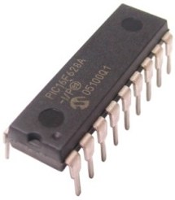
Introduction
A microcontroller unit (MCU) is a single-chip computer.
Microcontroller units (MCU) are one of the most significant integrated circuits (IC) in the technological evolution.
Among the competing microcontroller products, the PIC (Peripheral Interface Controller) Microcontroller by Microchip Inc. has been very popular
MCU programmers are important tools today, as well as demo boards, or learning kits especially for those new in MCU interfacing.

Slide 5
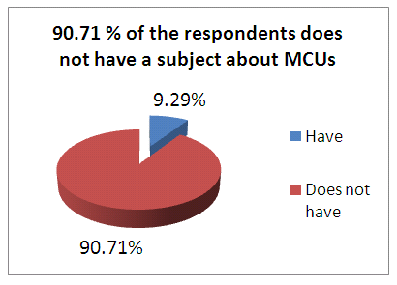
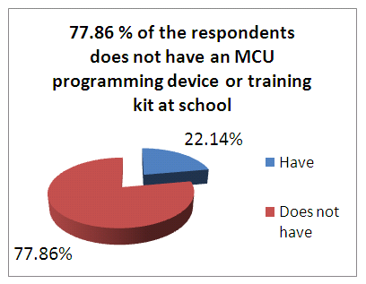
Introduction
The developers conducted a survey and some interviews to BSECE and BSCoE Students regarding MCUs

Slide 6
Introduction
Interviews show that they have to deal with MCUs in their projects and thesis proposals despite of the deficiency of related knowledge and resources.
If the students have a MCU programming device and training kit, they can gain the necessary knowledge and experiences about MCUs through experiments.

Slide 7
Statement of the Problem
How to design and develop a PC- Based Microcontroller Programmer and Training Kit?
How to develop a microcontroller programmer for a variety of PIC Microcontrollers?
How to develop a MCU training kit with a variety of electronic devices for interfacing?
How to develop a beginner-oriented software?
How to develop an efficient communication link between the host PC and the device?

Slide 8
Project Rationale
This research would be beneficial to:
Electronics and Computer Engineering Students
Hobbyists and other Electronics Enthusiasts
Future Researchers

Slide 9
Current State of Technology
A variety of MCU programming devices with their corresponding development kits and software are available in the market.

Slide 10
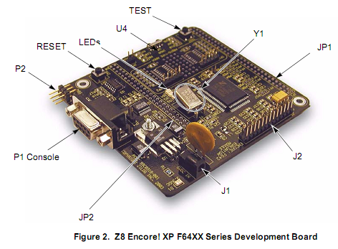
Current State of Technology
Serial/USB interface
Zilog Z8 Encore MCU
Connection headers
MCU cannot be removed from board
ZDS IDE Software
Figure 1.1 Z8 Encore! XP F64XX Series Development Board

Slide 11
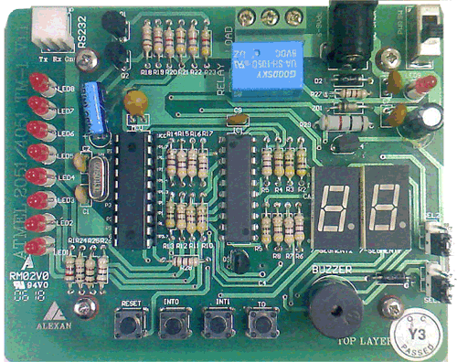
Current State of Technology
LEDs, 7 segment, buzzer, relay, pushbuttons
Atmel MCU
Ordinary socket limited to 18-pins
Serial interface only
Figure 1.2 Alexan 8051 Training Module 1

Slide 12
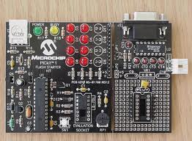
Current State of Technology
Serial/USB interface
LEDs
Ordinary socket limited to 14-pins PIC MCU
Connection headers
MPLAB IDE
Figure 1.3 Microchip PIC Kit 1

Slide 13
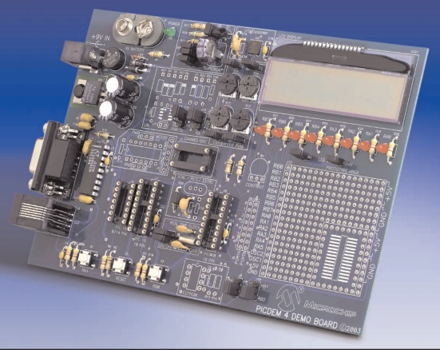
Current State of Technology
Expansion for PICkit
LED, LCD, pushbuttons
Ordinary socket limited to 8/14/18-pins PIC MCU
Connection headers
MPLAB IDE
Figure 1.4 Microchip PIC Dem 4

Slide 14
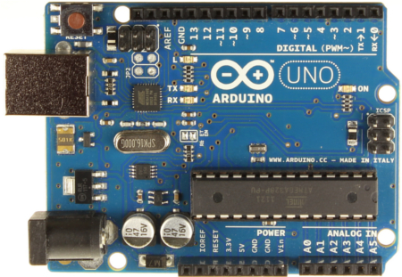
Current State of Technology
Standalone programmer for Atmel MCUs
USB interface
Connection headers for interfacing
Arduino IDE
Figure 1.5 Arduino UNO board

Slide 15
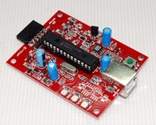
Current State of Technology
Standalone programmer for PIC MCUs
USB interface
MPLAB IDE
Figure 1.5 ePIC-KIT2

Slide 16

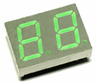
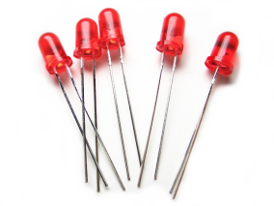
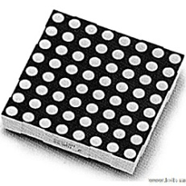
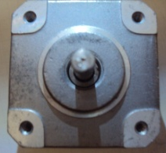
The project adapted these properties:
USB interface
Connection headers for interfacing
GUI software environment
LEDs, 7-segment, LCDs
Added features:
40-pin ZIF socket
Virtual emulator
Dot matrix, motor, and temperature sensor

Slide 17
Objectives
This project aims to develop a PC - Based Microcontroller Programmer and Training Kit
Develop a microcontroller programmer for a variety of PIC Microcontrollers
Develop an MCU training kit with a variety of electronic devices
Develop a beginner- oriented software with Virtual Emulator
Develop an efficient communication link between the host PC and the device.

Slide 18
Scope
The MCU programming device can program PIC Microcontrollers, such as 8/14/18/28 and 40- pin DIP (Dual In-line Package) types.
The device can simplify removing of MCU from the programming device through the included 40-pin ZIF (Zero Insertion Force).
The programming device also supports reading from and writing to standard 24Cxx series of EEPROM
The device can control the training kit modules containing electronic devices, such as LEDs, Dot Matrix Display, 7 segment Display, pushbuttons, LCD, motor and temperature sensor

Slide 19
Scope
The project software can simplify programming for the user through a software with predefined MCU experiments and a Virtual Emulator.
The project software also allows the user to create his own code for the training kits through the ‘Advanced Mode’.
The project can be interfaced with the host PC through the use of standard USB Interface.

Slide 20
Limitations
The MCU programmer can only accommodate 8-bit PIC Microcontrollers and 24Cxx EEPROMs.
The ZIF socket of the MCU Programmer can only handle DIP (Dual In-Line Package) chips.
The training kit would not include transceivers, servo motors, motion sensors, and other advanced electronic devices.
The software would only run on Windows XP systems.
The Virtual Emulator can only simulate the predefined experiments in Beginner mode

Slide 21
Theoretical Framework
PC-Based Microcontroller Programmer and Training Kit

Slide 22
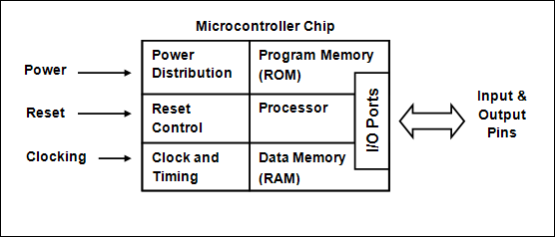
Microcontroller Units (MCU)
A microcontroller unit (MCU) is a single-chip computer.

Slide 23
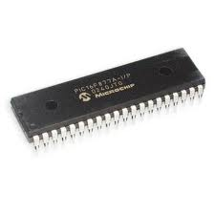
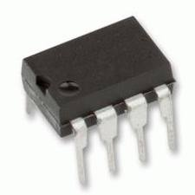
PIC Microcontrollers
Originally known as the PIC (for Peripheral Interface Controller) , the PIC MCU consists of over 400 variations (or Part Numbers), each designed to be optimal in different applications

Slide 24
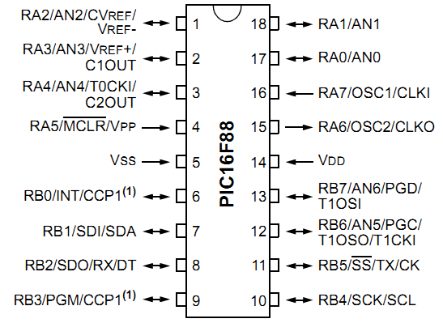
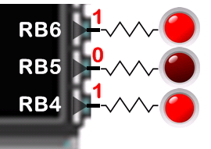
PIC MCU Ports
Ports represent physical connection of the PIC MCU’s processor to the outside world in the form of the pins. Ports in a PIC MCU are bi-directional.

Slide 25
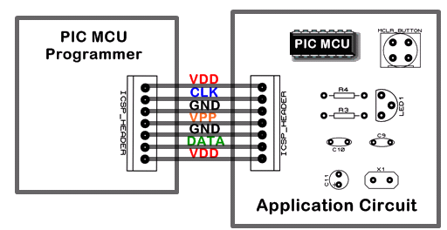
ICSP (In-Circuit Serial Programming™)
The PIC MCUs’ In-Circuit Serial Programming (ICSP) capability allows the MCU to be programmed using simple circuitry and without being removed from the application circuit.

Slide 26
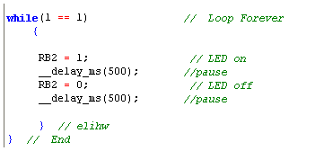
C Programming Language
For modern systems, C is the programming language of choice because it is available for a wide range of systems and processors (including the PIC® microcontrollers).

Slide 27
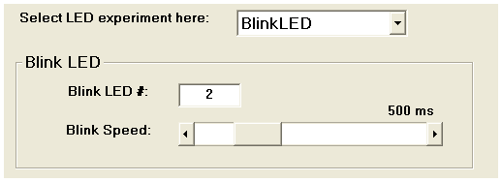
GUI (Graphical User Interface)
A graphical user interface (GUI) is a human-computer interface that uses windows, icons and menus and which can be manipulated by a mouse (and often to a limited extent by a keyboard as well).

Slide 28
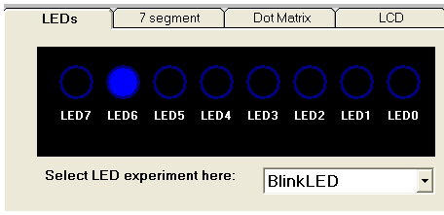
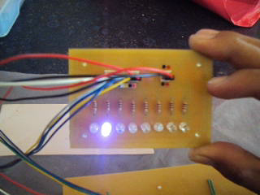
Emulation
Emulation refers to the ability of a computer program or electronic device to emulate (imitate) another program or device.

Slide 29
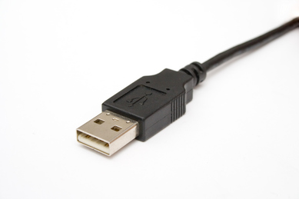
USB (Universal Serial Bus)
USB allows high-speed, easy connection of peripherals to a PC.

Slide 30
Project Design
PC-Based Microcontroller Programmer and Training Kit

Slide 31
Project Design
The PC Based Microcontroller Programmer and Training Kit is a device that allows users to program PIC Microcontrollers and test the programs using electronic devices.
It simplifies programming for the user through graphical predefined experiments with emulation.

Slide 32
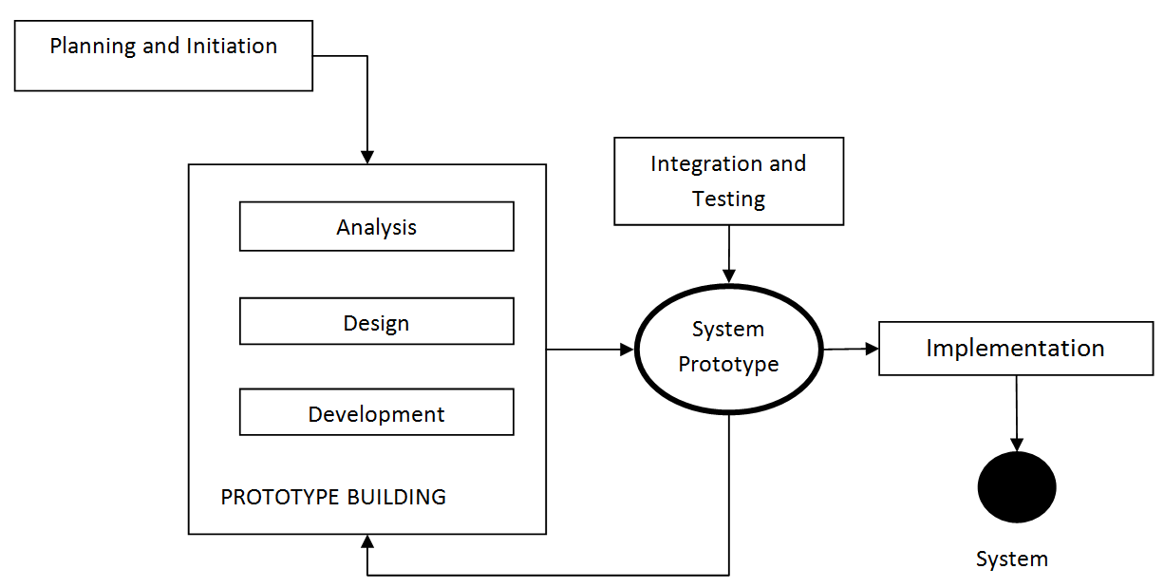
Project Methodology
Figure 3.1 Prototyping Model

Slide 33
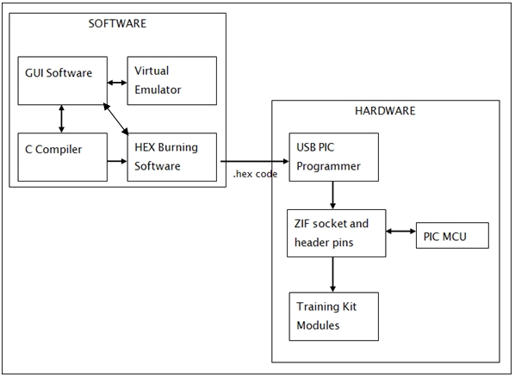
Project Design
Figure 3.2 Block Diagram

Slide 34
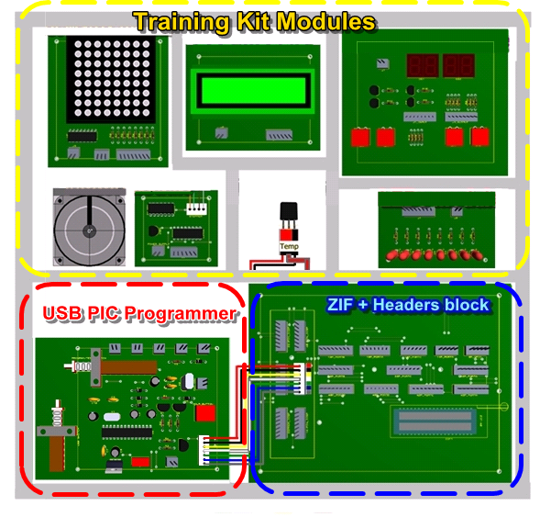
Project Hardware

Slide 35
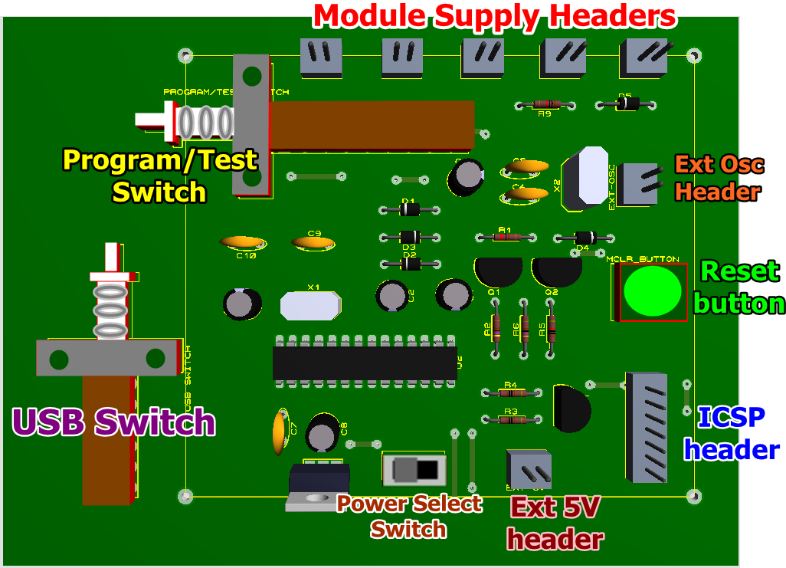
USB PIC Programmer
Hardware Components

Slide 36
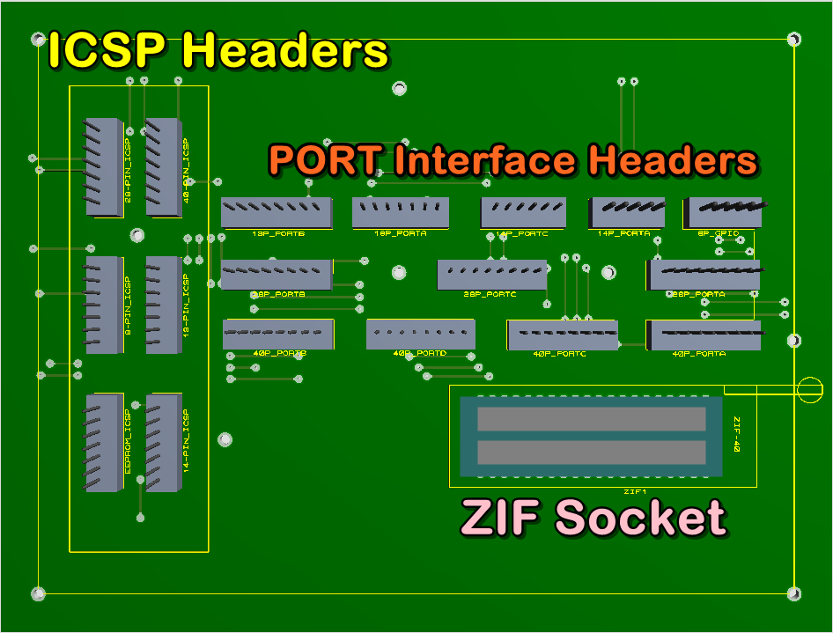
ZIF+Headers Block
Hardware Components

Slide 37
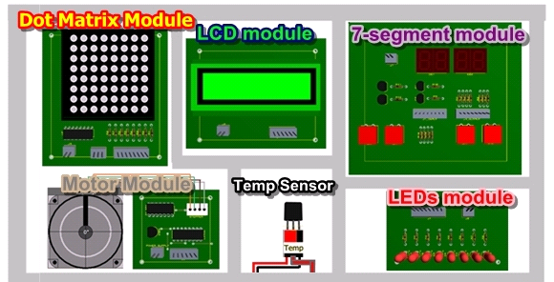
Training Kit Modules
Hardware Components

Slide 38
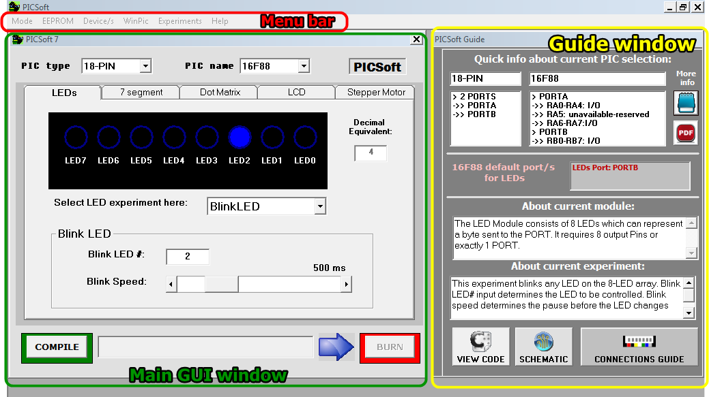
Project Software

Slide 39
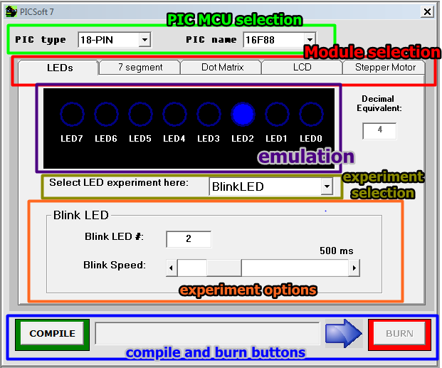
Project Software
Main GUI Window

Slide 40
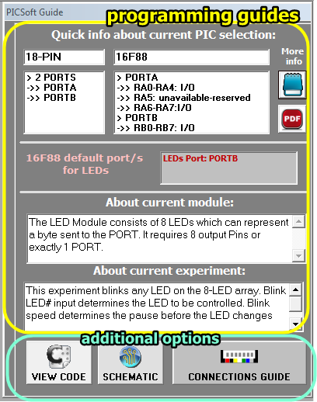
Project Software
Guide Window

Slide 41

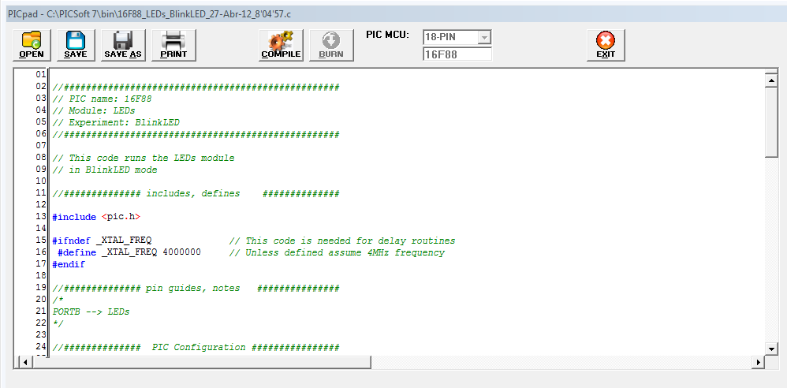
Project Software
Menu bar
Advanced mode – code editor

Slide 42

Project Software
Menu bar
Burn hex file to EEPROM
Use 2 or 3 modules for interfacing
Burn a hex directly to a PIC MCU
View experiment documents
View help documents

Slide 43
Workbook and Manual
The project also includes a document that consists of the user manual and workbook
The user manual contains guides on installation and general use of the project
The workbook consists of experiments that can be followed by the user in the course of MCU programming and interfacing

Slide 44
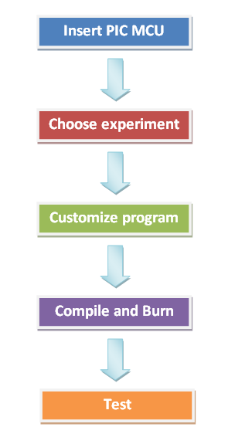
Conceptual Framework

Slide 45
Performance Analysis
PC-Based Microcontroller Programmer and Training Kit

Slide 46
Experimental
The project was tested continuously to measure its efficiency and reliability. The initial testing consists of using each of the module for 30 times with different experiments and PIC MCU used.
Percent error = (total no. of trials – successful trials) x 100
Total no. of trials

Slide 47
Module | Total no. of trials | No. of successful trials | Percent error
LEDs | 30 | 29 | 3.33%
7-segment | 30 | 29 | 3.33%
Dot Matrix | 30 | 29 | 3.33%
LCD | 30 | 28 | 6.67%
Motor | 30 | 29 | 3.33%
Temperature Sensor | 30 | 27 | 10%
TOTAL | 180 | 171 | 5 %
Table 4.1 Percent error of each training kit module

Slide 48
Results and Analysis
The project was evaluated by 50 respondents consisting of BSCoE students from STI College Rosario and Cavite State University - Rosario. The evaluation consists of six different criteria. The following table presents the results of the evaluation.

Slide 49
Criteria | Mean | Rating
Functionality | 4.37 | Very Good
Reliability | 4.25 | Very Good
Aesthetics | 4.29 | Very Good
Durability | 4.37 | Very Good
Economy | 4.37 | Very Good
Safety | 4.35 | Very Good
Table 4.2 The Overall Rating of the Prototype for each Criteria

Slide 50

Overall Mean
Based on all of the criterias, it showed that the student evaluators recognized the good qualities of the project, as well as its potential for improvement. It is indicated by the overall mean of 4.33, which means a Very Good rating.

Slide 51
Results and Analysis
The developers also gathered feedback from the faculty members from STI, PUP and CvSU.
The responses generally show that they are interested with the project, especially regarding its functionality in programming the MCU and how it is interfaced to the training kit modules.
According to them, the project can also be competitive in the market, for it is advantageous to beginners in MCUs, and an effective tool in testing MCU programs.
The faculty respondents also expressed that the project can be beneficial to the institution with its usefulness. They also gave suggestions that are essential in improving the project.

Slide 52
Demonstration
PC-Based Microcontroller Programmer and Training Kit

